Slide 1

FOG Computing Based On IOT
Under the Guidence Of
Prof: Sanjib Mitra
Tamojit Saha
Roll No: 16900317002
Subhayan Bhowmick
Roll No: 16900317005

Slide 2
Contains:
Introduction Of Fog Computing
Cloud Computing
Internet Of Things
Difference Between Fog and Cloud Computing
Basic Diagram
Working Principles
Advantages
Disadvantages
Application
Conclusion and Future Work
Reference

Slide 3

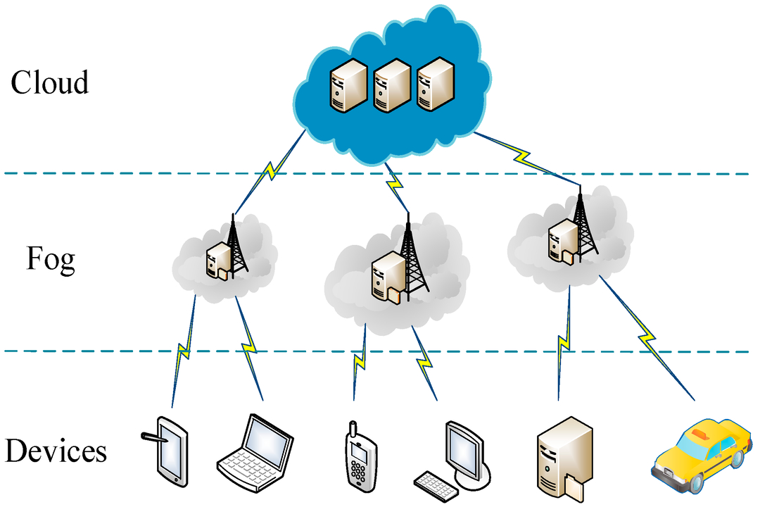
Fog Computing:
Introduction:
A technology that extends cloud computing and services to the edge of the network.
data, compute, storage, applications are located somewhere between the data source and the cloud.
First invented by CISCO

Slide 4
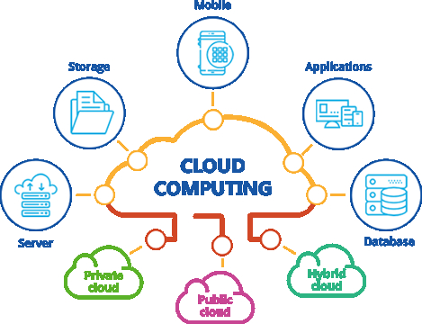
Cloud computing
storing and accessing data programs over Internet
Example: Google’s Gmail
maintains the network-connected hardware via a web application.
Information and data is stored on physical or virtual servers.
Benefits: Increase speed, capacity. Reduce spending money on maintaining data centers

Slide 5
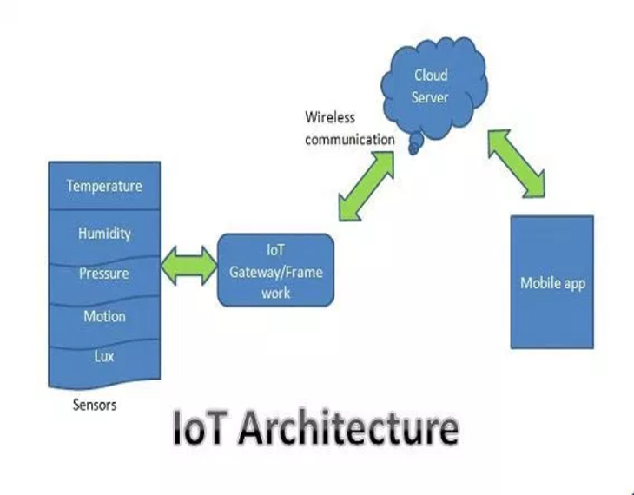
Internet of things
SENSORS and ACTUATORS:
physical quantity converts into electrical
CONNECTIVITY:
received signals uploaded on the network
PEOPLE and PROCESSES:
inputs combined into bidirectional system for better decision making.

Slide 6
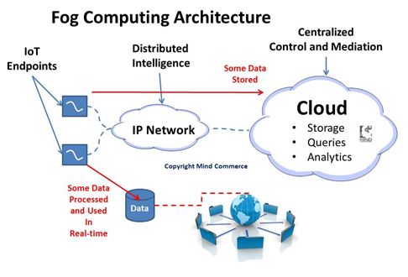
FOG Architecture
Data Management in Fog Computing
IOT End-Point:
Real-time Front-end
Off-line Back-end (centralized Cloud storage)

Slide 7
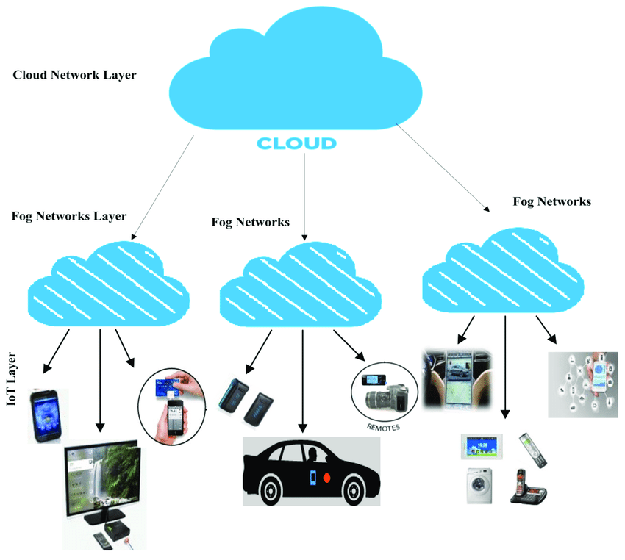
FOG Computing Diagram:

Slide 8
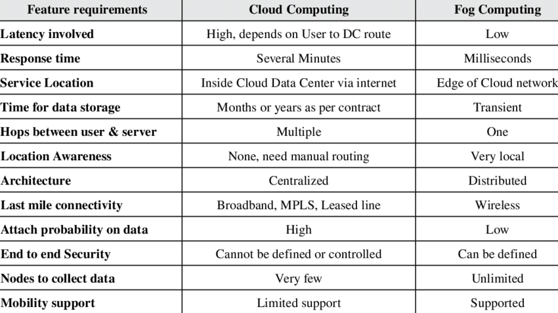
FOG Computing vs Cloud Computing Based On IoT

Slide 9
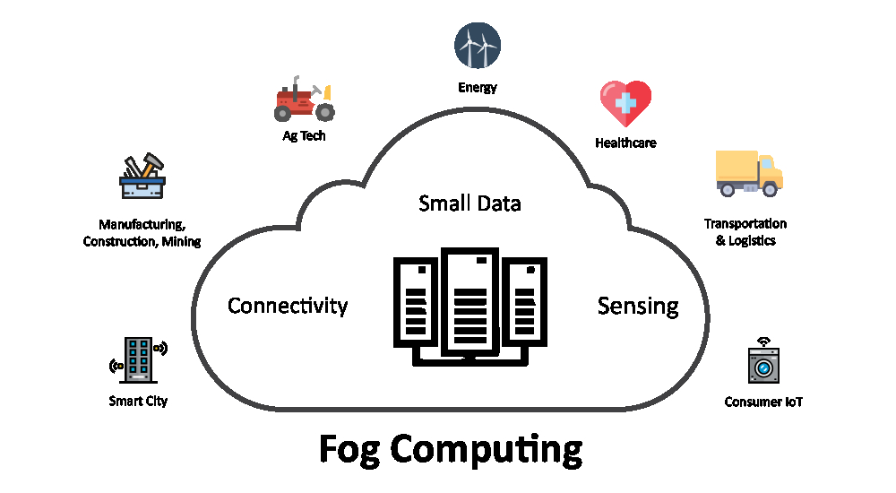
Application:
Smart Cities
Smart grid
Health care system
Traffic control system
Visual Security
Monitoring and response functions, climate control

Slide 10
Advantages
Reduce amount of data sent to the cloud
Conserve network bandwidth
Improve system response time
Improve security by keeping data close to the edge
Support mobility
Minimize network and internet latency

Slide 11
Disadvantages
Physical location takes away any data to any where any place disconnect from cloud
Security issue, IP address spoofing , man-in–the–middle attacks
Privacy issues
Lack of availabilities
Cost of FOG equipment, Hardware
Wireless network security concern

Slide 12
Conclusion and Future Work
Increase in data and cloud service
Fog helping reduce latency and improving the user experience.
in vehicle-to-vehicle communications systems, smart grid deployments or telemedicine and patient care environments
Hardware manufacturers, such as Cisco, Dell and Intel, are working with IoT analytics and machine-learning vendors to create IoT gateways and routers that support fogging.

Slide 13
Reference:
Fog Computing: Mitigating Insider Data Theft Attacks in the Cloud, USA
Ben-Salem M., and Stolfo Angelos D. Keromytis, “Fog computing: Mitigating Insider Data Theft Attacks in the Cloud,” IEEE symposium on security and privacy workshop (SPW) 2012.
Ben-Salem M., and Stolfo, “Decoy Document Deployment for Effective Masquerade Attack Detection,” Computer Science Department, Columbia University, New York.
F. Bonomi, "Connected vehicles, the internet of things, and fog computing," in The Eighth ACM International Workshop on Vehicular Inter-Networking (VANET), Las Vegas, USA, 2011.
F. Bonomi, R. Milito, J. Zhu, and S. Addepalli, "Fog computing and its role in the internet of things," in Proceedings of the First Edition of the MCC Workshop on Mobile Cloud Computing, ser. MCC'12. ACM, 2012, pp. 13-16.

Slide 14
Thank You

